Slide 1
E-world and Court in E-stonia
Daimar Liiv
Judge
Tallinn Administrative Court

Slide 2
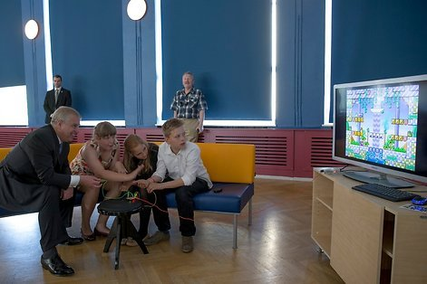
E-stonia
Estonians were first in USSR to start to introduce computers into education system.
Nõo Secondary School received in 1965(!!!) computercenter with Tartu University electronic computer „Ural-1“. It was the first school computing center in the entire USSR and computer teaching was started in school.

Slide 3
E-stonia
Estonians were first in the USSR in 1980ties to start use computers and xerox machines in private organisations which finally destroyed information and printing monopoly of the communist state as well this state
There was little number of real executive power institutions in Estonia and therefore no well-established paper bureaucracy and large paper based information bases in public administration.
Initial foreign aid in the beginning of 1990 for the public administration consisted often of computers. It was decentralized and lot of diferent equipment appeared from the beginning in state sector which was mainly used for word-processing and for creating initial databases.
Estonians were eager to start use of computers – we became „westeners“ through it!
Banking system was created from zero and with computer-based infomanagment.

Slide 4
Estonia is a E-state
Estonia has by far the most highly-developed national ID card system in the world.
Much more than simply a legal picture ID, the mandatory national card serves as the digital access card for all of Estonia’s secure e-services.
The chip on the card carries embedded files which, using 2048-bit public key encryption, enable it to be used as definitive proof of ID in an electronic environment.
There are more than 1.2 million active e-ID cards in Estonia. That’s nearly 94% of Estonia's 1.3 million residents
Here are some examples of how the ID Card is regularly used in Estonia:
As a national ID card for legal travel within the EU for Estonian citizens
As the national health insurance card
As proof of identification when logging into bank accounts from a home computer
As a pre-paid public transport ticket in Tallinn and Tartu
For digital signatures
For i-voting
For accessing government databases to check one’s medical records, file taxes, etc.
For picking up e-Prescriptions

Slide 5
Just some cool services (1)
e-Business Register
Estonia’s e-Business Register is an advanced and secure tool that allows entrepreneurs to register their new business online in just minutes (18 minutes), without having to go to a notary or some other official.
e-Cabinet
The Information System of Government Sessions, better known as e-Cabinet, is a powerful tool that the Estonian government uses to streamline its decision-making process.
The duration of typical Estonian cabinet meetings since using e-Cabinet: 30-90 minutes
It lets ministers prepare for cabinet meetings, conduct them and review minutes, entirely without paper.
e-Law
The e-Law system is the Estonian Ministry of Justice’s online database for draft legislation.
More properly called the Electronic Coordination System for Draft Legislation, it allows the public to access every piece of draft law that has been submitted since February 2003.
Readers can see who submitted the legislation, its status, and the changes made to it as it passed through the parliamentary process.
i-Voting
Internet voting, or ‘i-voting’, is a system that allows voters to cast their ballots from any internet-connected computer, anywhere in the world.
In the 2015 Parliamentary Elections, Internet voting accounted for 30,5 percent of the votes cast. Estonians worldwide cast their votes from 116 different countries.

Slide 6
Just some cool services (2)
e-Tax
E-Tax is the electronic tax filing system set up by the Estonian Tax and Customs Board and it was introduced publicly in 2000.
Using a secure ID, a taxpayer logs onto the system, reviews their data in pre-filled forms, makes any necessary changes, and approves the document with a digital signature. The process typically takes three to five minutes. From 2015 one-click tax returns are also available, all known data is displayed to the citizen together with the calculated result, then all they have to do is click on the confirmation button; all this takes less than a minute.
Each year around, 95 percent of tax declarations in Estonia are filed electronically.
State e-Services Portal
The State Portal, eesti.ee, is a website that acts as a one-stop-shop for the hundreds of e-services offered by various government institutions introduced in2003. It is single point of contact – 99% of all state services
Rather than having to hunt for a particular service on the Internet, a user can simply head to this gateway site and find the appropriate link.
Electronic Land Register
The e-Land Register is a one-of-a-kind web application that contains information of all ownership relationship and limited real rights of real estates and land parcels. Currently, there are 1.003.946 immovables in the Land Register.
A critical tool for the real-estate market, it provides total transparency; listing the registered owner of each property holding, showing the property boundaries and providing other information that potential buyers would need to know.
Paired with a geographical information system (GIS), the electronic land register delivers real-time geographical data through the X-road, enabling advanced map-based visualizations that power many of the location-based services in Estonia.

Slide 7
X-road
X-Road is the backbone of e-Estonia. It’s the invisible yet crucial environment that allows the nation’s various e-services databases, both in the public and private sector, to link up and operate in harmony.
X-Road is the all-important connection between these databases, the tool that allows them to work together for maximum impact. All of the Estonian e-solutions that use multiple databases use X-Road. All outgoing data from the X-road is digitally signed and encrypted. All incoming data is authenticated and logged.
Originally X-Road was a system used for making queries to the different databases. Now it has developed into a tool that can also write to multiple databases, transmit large data sets and perform searches across several databases.
In 2013 over 287 million queries were done over X-road.
Over 170 databases offer their services over X-Road in Estonia.
Over 2,000 services are used over X-Road in Estonia.
Over 900 organisations use X-Road daily in Estonia.
More than 50% of the inhabitants of Estonia use X-Road through the information portal eesti.ee.

Slide 8
E-Legislation
1996 rather originaal Databases Act was passed by the Parliament (substantially amended in 2004 and introduced tot he Public Information Act in 2008) as well as Data Protecion Law – mainly on formation of public databases
2000 - Public Information Act (was modernised in 2007) https://www.riigiteataja.ee/en/eli/518012016001/consolide
Regulation of the Government of the Republic on the Administration System of the State Information System (2001).
Regulation of the Government of the Republic on the Data Exchange Layer of Information Systems (2008). Population Register Act.
2000 – Digital Signatures Act https://www.riigiteataja.ee/en/eli/508072014007/consolide

Slide 9
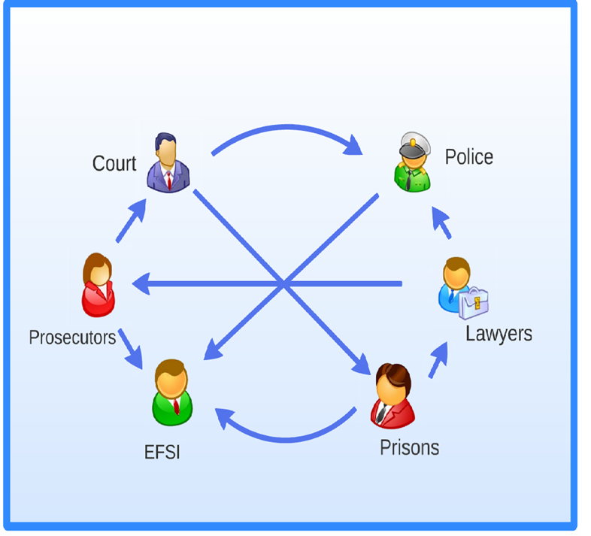
Computerisation of courts. Infosystem
Started chaotically in 1992, turning point was creation in 1996 of the Court Decision Register (centralized)

Slide 10
2006 Court Information System (v 1.0)

Slide 11
2014 Court Information System – KIS 2 New system based on E-file system
4 800 000 proceedings
Every minute 400-500 searches
Response time 0,7 sec
4 TB and 20 000 000 files, 1,1 TB database files

Slide 12
How did we get there with E-file?
Started in 2006
Launched in September 2009 with criminal and misdemeanor proceedings
Launched the Criminal Records in 2012
Launched the civil and administrative proceedings in 2014
As of 2017 no paper file, only digital file? Should provide for hyperlinks between documents and easier search options from the documents of the case file

Slide 13
How it works today

Slide 14
Problems
Initially too many interruptions as system was little tested
Training was almost absent
Sometimes slow
Search function needs development
Individualization of interface (working environment) needs to be trained and possibilities explained
Two screens are needed for really effective use!

Slide 15
Good points
You almost don`t need paper file
Everything is in one place
Judge does only writing and search for it – all ohter actions are done by secretary
Accessible over the Internet – you can work everywhere!
Almost all exchange of documents is rapid and parties are in most cases easily accessible
Back-up service works!

Slide 16
Summary – what we have today
Integrated IT systems
IT systems of courts, police, prosecutors´ office, company registries etc are connected via e-file system
Data between different systems is exchanged automatically
Court judgments are published in the National Gazette after entry into force
Audio and video
In criminal cases audio recording is compulsory – written minutes done after the session
In administrative cases court sessions are audio recorded with Liberty Court Player – no written minutes afterwards
Videoconference is used in court cases involving prisoners and other detainees
Also for hearing witnesses abroad
In criminal cases only in procedural matters (conditional release on parole etc)

Slide 17
Summary – what we have today
IT in court administration
Exact, up-to-date statistics in real time to monitor case load, judges´ performance
Easy detection of delays in court proceedings
Automatic case allocation, taking into account the complexity and volume of cases in order to guarantee equal allocation of workload between judges
CIS in integrated with calendars of the judges and staff and court room
Bookkeeping and monetary issues in one center

Slide 18
Summary – what we have today
Legislation supports use of IT in courts
and finally
Almost all clients and all judges and our staff have a high e-culture!!

Slide 19
What Estonian judges are still dreaming of…
Better screens and more powerful computers (Of course!)
Excellent and quick search machine
Voice recognition system
and finally
AI module for every judge for a fully compurerized decisionwriting ☺

Slide 20
Thank you for your attention!
Daimar Liiv
Judge
Tallinn Administrative Court
Pärnu mnt 7, Tallinn, 15082 Estonia
+ 372 6282704
daimar.liiv@kohus.ee
Skype: daimar1

